Slide 1
Computer & It’s generations.

Slide 2
Introduction To Computers
Its an electronic Device that is used for information Processing.
computer.. Latin word.. compute
Calculation Machine
A computer system includes a computer, peripheral devices, and software
Accepts input, processes data, stores data, and produces output
Input refers to whatever is sent to a Computer system
Data refers to the symbols that represent facts, objects, and ideas
Processing is the way that a computer manipulates data
A computer processes data in a device called the central processing unit (CPU)

Slide 3
Characteristics of Computer
Main characteristics of the computer is:
1.Automatic:it’s a automatic device.it carries out a job without any human intervention.
2. Speed: Computer is very fast and accurate device. It can process millions and millions of instructions within
seconds.
3. Accuracy: Computer results are highly accurate.it always give same accuracy in every calculation.
4. Diligence: Computer is free from problems like lack of
concentration, and confusions etc. Computer may never be confused like humans.

Slide 4
Characteristics of Computer (Continued)
5. Versatility: We can perform many different types of tasks on computer. One moment it might be busy in calculating the statistical date for annual performance evaluation of a business organization and next moment it might be working on playing movies.
6. Memory: Computers have a large amount of memory to hold a very large amount of data or information and can recall any of this information or data when required
7. No I.Q: it cannot take its own decisions and has to be instructed what to do and in what sequence.
8. No feelings: it cannot make judgments on feelings.

Slide 5
Computer generations
Generation & Description
First Generation
The period of first generation: 1946-1959. Vacuum tube based.
Second generation
The period of second generation: 1959-1965. Transistor based.
Third Generation
The period of third generation: 1965-1971. Integrated Circuit based.
Fourth Generation
The period of fourth generation: 1971-1980. VLSI microprocessor based.
Fifth Generation
The period of fifth generation: 1980-onwards. ULSI microprocessor based.
By tutorialspoint.com

Slide 6
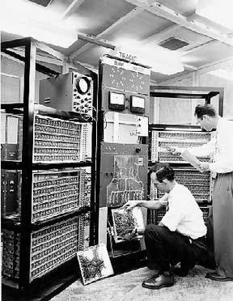
First Generation
The period of first generation was 1946-1959.
First generation of computers started with using vacuum tubes as the basic components for memory and circuitry for CPU (Central Processing Unit).
In this generation, mainly batch processing operating systems were used. In this generation, Punched cards, Paper tape, Magnetic tape Input & Output device were used.
There were machine codes and electric wired board languages used.
The main features of First Generation are :
Vacuum tube technology
Unreliable
Supported Machine language only
Very costly
Generate lot of heat
Slow Input/Output device
Huge size
Need of A.C.
Non-portable
Consumed lot of electricity
Some computers of this generation were :
ENIAC
EDVAC
UNIVAC
IBM-701
IBM-650
By tutorialspoint.com

Slide 7
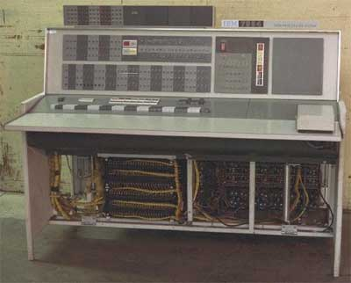
Second Generation
The period of second generation was 1959-1965.
This generation using the transistor were cheaper, consumed less power, more compact in size, more reliable and faster than the first generation machines made of vacuum tubes. In this generation, magnetic cores were used as primary memory and magnetic tape and magnetic disks as secondary storage devices.
In this generation, assembly language and high-level programming language like FORTRAN, COBOL were used.
There were Batch processing and Multiprogramming Operating system used.
The main features of Second Generation are :
Use of transistors
Reliable as compared to First generation computers
Smaller size as compared to First generation computers
Generate less heat as compared to First generation computers
Consumed less electricity as compared to first generation computers
Faster than first generation computers
Still very costly
A.C. needed
Support machine and assembly languages
Some computers of this generation were :
IBM 1620
IBM 7094
CDC 1604
CDC 3600
UNIVAC 1108
By tutorialspoint.com

Slide 8
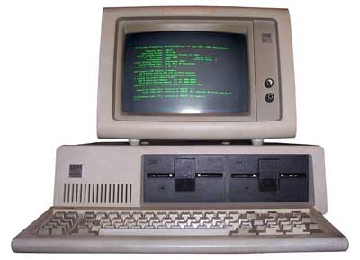
Third Generation
The period of third generation was 1965-1971.
The third generation of computer is marked by the use of Integrated Circuits (IC's) in place of transistors. The IC was invented by Jack Kilby.
In this generation, Remote processing, Time-sharing, Real-time, Multi-programming Operating System were used.
High-level language (FORTRAN-II TO IV, COBOL, PASCAL PL/1, BASIC, ALGOL-68, etc.) were used during this generation.
The main features of Third Generation are :
IC used
More reliable
Smaller size
Generate less heat
Faster
Lesser maintenance
Still costly
A.C. needed
Consumed lesser electricity
Support high-level language
Some computers of this generation were:
IBM-360 series
Honeywell-6000 series
PDP(Personal Data Processor)
IBM-370/168
TDC-316
By tutorialspoint.com

Slide 9
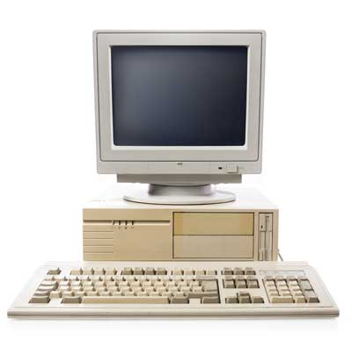
Fourth Generation
The period of Fourth Generation was 1971-1980.
The fourth generation of computers is marked by the use of Very Large Scale Integrated (VLSI) circuits. VLSI circuits having about 5000 transistors.
In this generation, Time sharing, Real time, Networks, Distributed Operating System were used.
All the higher level languages like C and C++, DBASE, etc., were used in this generation.
The main features of Fourth Generation are :
VLSI technology used
Very cheap
Portable and reliable
Use of PC's
Very small size
Pipeline processing
No A.C. needed
Concept of internet was introduced
Great developments in the fields of networks
Computers became easily available
Some computers of this generation were :
DEC 10
STAR 1000
PDP 11
CRAY-1 (Super Computer)
CRAY-X-MP (Super Computer)
By tutorialspoint.com

Slide 10
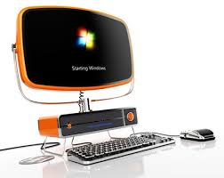
Fifth Generation
The period of Fifth Generation is 1980-till date.
In the fifth generation, the VLSI technology became ULSI (Ultra Large Scale Integration) technology, resulting in the production of microprocessor chips having ten million electronic components.
This generation is based on parallel processing hardware and AI (Artificial Intelligence) software.
All the higher level languages like C and C++, Java, .Net, etc., are used in this generation.
The main features of Fifth Generation are :
ULSI technology
Development of true artificial intelligence
Development of Natural language processing
Advancement in Parallel Processing
Advancement in Superconductor technology
More user friendly interfaces with multimedia features
Availability of very powerful and compact computers at cheaper rates
Some computers types of this generation are :
Desktop
Laptop
NoteBook
UltraBook
ChromeBook
By tutorialspoint.com

Slide 11
Thank you.
Any question?

